Slide 1
MatRaptor: A Sparse-Sparse Matrix Multiplication Accelerator Based on Row-Wise Product

Slide 2
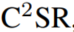
Contributions
analyze different dataflows of SpGEMM by comparing and contrasting them against data reuse and on-chip memory requirements.
introduce , storage format that allows different parallel processing engines (PEs) to access the data in a vectorized and stream new hardware-friendly sparse ming manner leading to high utilization of the available memory bandwidth.
We design a novel SpGEMM accelerator named MatRaptor, which efficiently implements the row-wise product approach and fully exploits the C2SR format to achieve high performance.

Slide 3
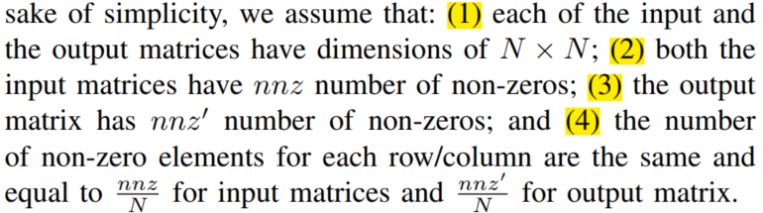

Inner product, outer product, row-wise product, column-wise product.
Discuss (data reuse) and (on-chip memory requirements).

Slide 4
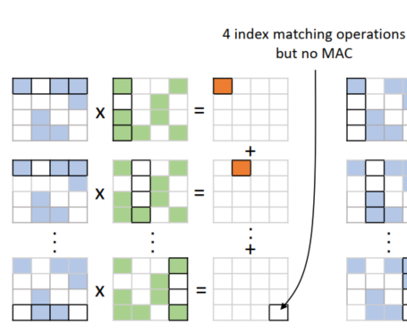
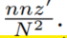
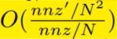
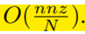
Inner Product
the probability that such index matching produces a useful output (i.e., any of the two indices actually matched) is
Data reuse for the inner product approach is
The on-chip memory requirements for this approach is
the data reuse for inner product approach is low; however, the on-chip memory requirements are also low.
Disadvantage:
approach is low; however, the on-chip memory requirements are also low.
the output matrix is typically also sparse, which leads to a significant amount of wasted computation.
It performs a dot product of two sparse vectors, which is very inefficient since it requires index matching where a MAC is performed only when the indices of the non-zero elements from the two vectors match;

Slide 5
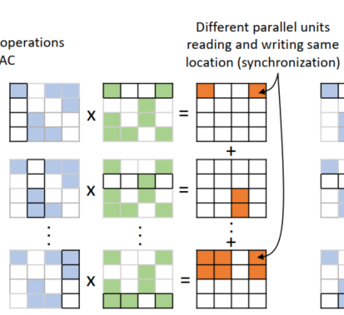
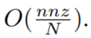
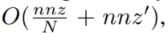
Outer Product
Data reuse for the outer product approach is
The on-chip memory requirements for this approach is
Advantage:
computing only non-zero entries of the output matrix
not performing any index matching while multiplying the inputs.
Disadvantage:
two input matrices still need to be stored in different formats
Partial sums need synchronization among them.
For output reuse the partial sums are typically stored on-chip.

Slide 6
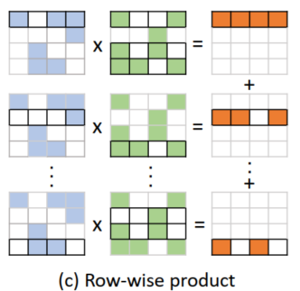
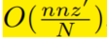
Row-Wise Product
all the non-zero elements from a single row of matrix A are multiplied with the non-zero entries from the corresponding rows of matrix B,
Advantage:
Consistent Formatting:
Elimination of Index Matching: The core computation in this approach is scalar-vector product; hence it computes only non-zero entries of the output matrix。
Elimination of Synchronization: allows multiple PEs to compute different rows of the sparse output matrix
Low On-Chip Memory Requirements Since a single output row is computed at a time, the required output buffer size is in the order of
Disadvantage：
（1）data-reuse of matrix B 相比 外积低。The low on-chip data reuse has more impact on the performance when the density of matrix B is high.
（2）PE间有load imbalance的问题，当矩阵B的density较大时，影响更明显
在极度稀疏时，data reuse
并没有比外积少特别多

Slide 7
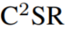
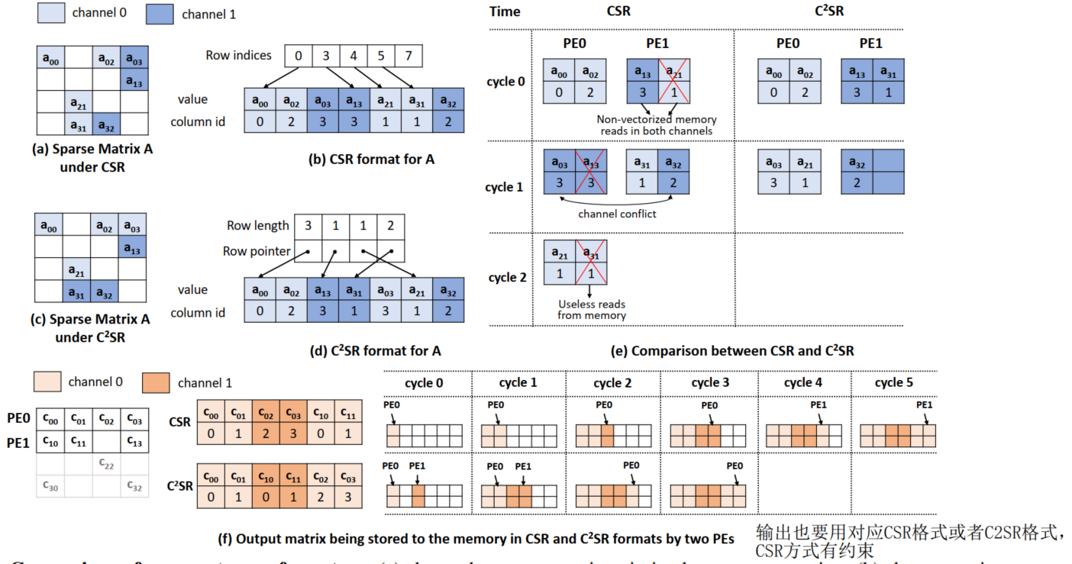

Slide 8
No Channel Conflicts:
Vectorized and Streaming Memory Reads:
Parallel Writes to the Output Matrix:
MatRaptor solves：
(i) by allowing all the PEs to work completely asynchronously. Such asynchronous execution is made possible by the C2SR format, which partitions the address space of the output matrix between different PEs and allows the PEs to independently produce the results of the output matrix. MatRaptor tackles (ii) by doing a round robin allocation of rows to different PEs. This effectively ensures that for the sparse matrices with few high-density regions, the non-zero elements in these regions are approximately uniformly split among different PEs.

Slide 9
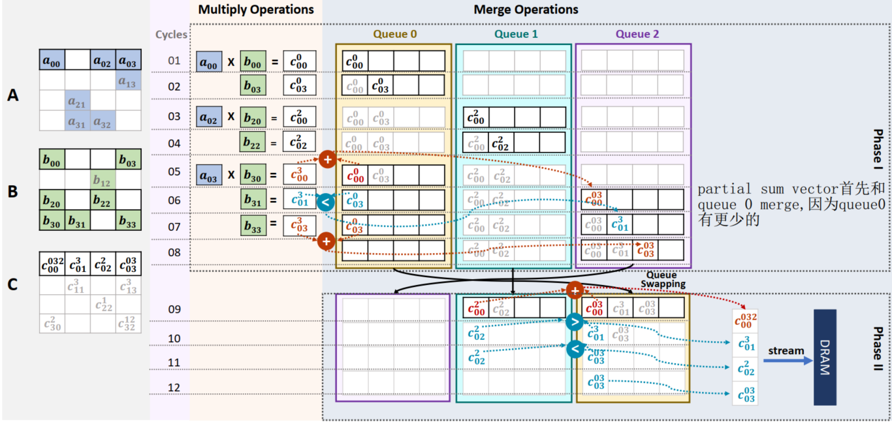
SpGEMM computation within a PE consists of two major operations:

Slide 10
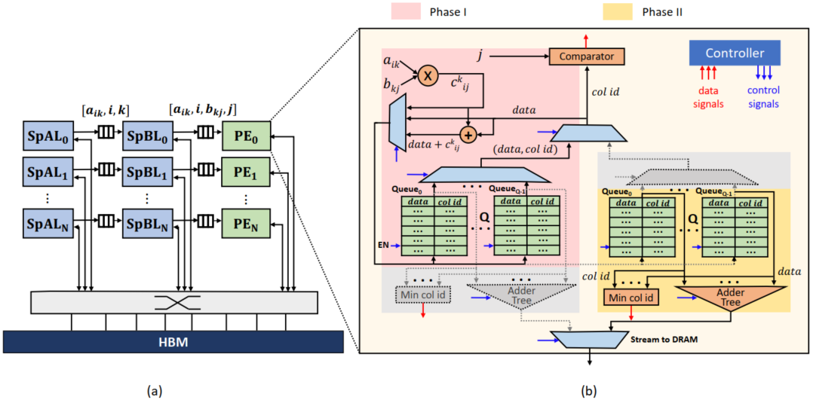
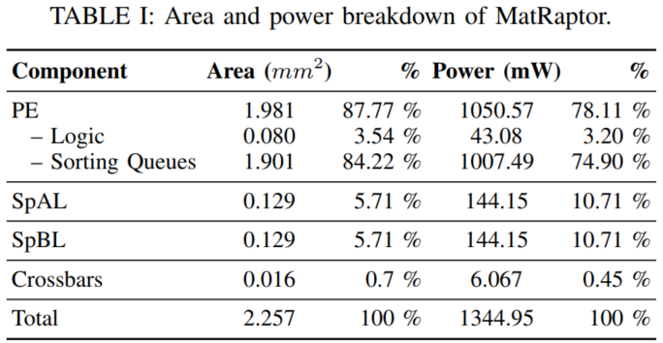
MatRaptor architecture

Slide 11
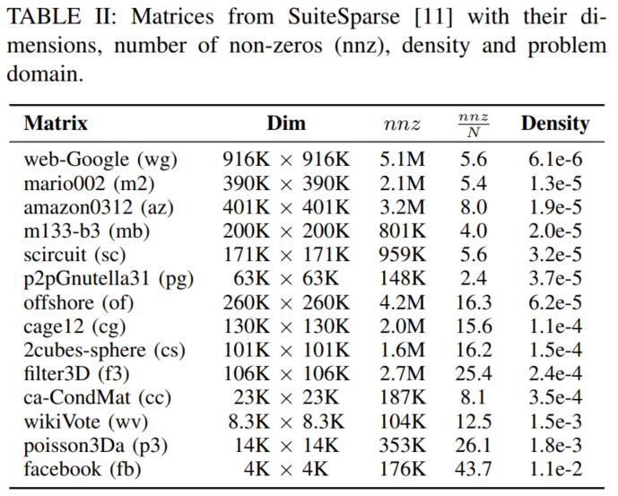
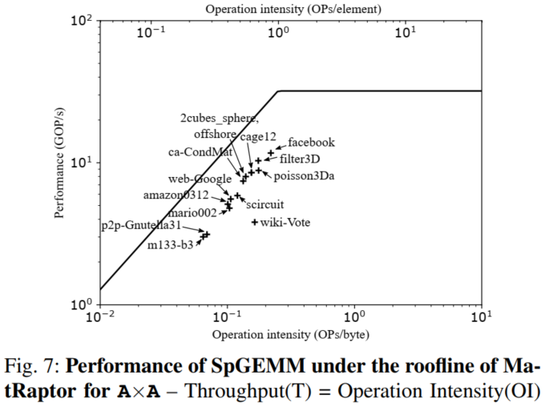
Notes:
DBID直接把input的维度HxWxC变成HxWxCM,M是位宽。就是按bit切分。而BIL就是在切分好input data和原始的第一层卷积之间加入一个 BIL和一个HxWxk对的filters
温度计编码可以 更好的保存特征 在二值化以后的相似度

Slide 12
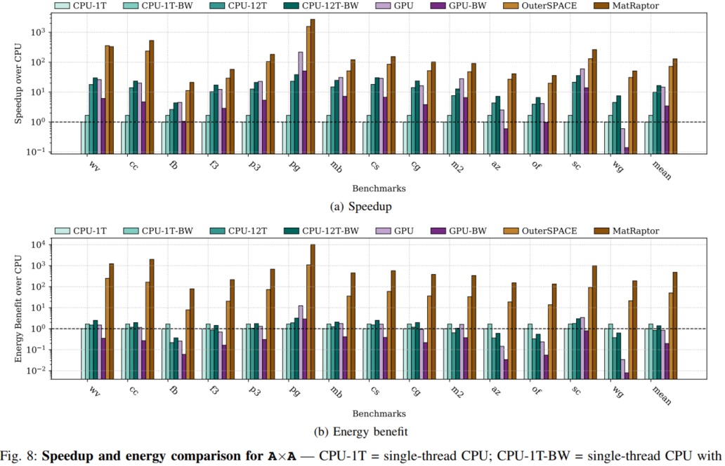

Slide 13
